Slide 1
Chapter 10:
Data Quality and Integration
Modern Database Management
10th Edition
Jeffrey A. Hoffer, V. Ramesh,
Heikki Topi
© 2011 Pearson Education, Inc. Publishing as Prentice Hall

Slide 2
Objectives
Define terms
Describe importance and goals of data governance
Describe importance and measures of data quality
Define characteristics of quality data
Describe reasons for poor data quality in organizations
Describe a program for improving data quality
Describe three types of data integration approaches
Describe the purpose and role of master data management
Describe four steps and activities of ETL for data integration for a data warehouse
Explain various forms of data transformation for data warehouses

Slide 3
Data Governance
Data governance
  High-level organizational groups and processes overseeing data stewardship across the organization
Data steward
  A person responsible for ensuring that organizational applications properly support the organization’s data quality goals
Notes:
Data governance
High-level organizational groups and processes overseeing data stewardship across the organization! The group may be a committee, or a dedicated grup
Data steward
A person responsible for ensuring that organizational applications properly support the organization’s data quality goals

Slide 4
Requirements for Data Governance
Sponsorship from both senior management and business units
A data steward manager to coordinate data stewards
Data stewards for different business units, subjects, and/or source systems
A governance committee to provide data management guidelines and standards
Notes:
Because data management is an orver-arching process control, you need senior management buy in and as well as each individual units.
A data steward manager to coordinate data stewards. You may have a data steward for each application or for each department depending on complexity
Data stewards for different business units, subjects, and/or source systems
A governance committee to provide data management guidelines and standards -

Slide 5
Importance of Data Quality
Minimize IT project risk
Make timely business decisions
Ensure regulatory compliance
Expand customer base
Notes:
Data Quality is typically one of the most important goals of DG!
Minimize IT project risk – bad data can cause applications to crash, and increase timeline on projects
Make timely business decisions -> if data is not in a format that is ready to support decisions, you cant make timely decisions
Ensure regulatory compliance -> As we seen with SOX regulations, there are many other regulatory compliance that needs to be met. GDPR in Europe, SOX, SOC2
Expand customer base -> poor data quality makes it diffurcult to run marketing campaigns and run sales analytics therefore reduces the company ability to grow their customer base

Slide 6
Characteristics of Quality Data
Uniqueness
Accuracy
Consistency
Completeness
Timeliness
Currency
Conformance
Referential integrity
Notes:
Uniqueness -> each instance of an object is identifiable. If your are storing an employee if record uniquely identifying an employee
Accuracy -> do we have erroneous data. This can be created due to bugs, process control, folks not updating the system, or poor design
Consistency -> is the data the same format throughout the application or the database
Completeness -> are there pieces of data missing. Is it complete?
Timeliness – can management draw insight and intelligence from that data.
Currency -> is the data current or we are dealing with older set of data. Even data sets that you may think is static may change
Conformance -> does it conform to the standard set forth by data governance standards
Referential integrity -> in a relational database are the relationships enforced properly

Slide 7
Causes of poor data quality
External data sources
  Lack of control over data quality
Redundant data storage and inconsistent metadata
  Proliferation of databases with uncontrolled redundancy and metadata
Data entry
  Poor data capture controls
Lack of organizational commitment
  Not recognizing poor data quality as an organizational issue
Notes:
External data sources
Lack of control over data quality! -> you cant control data from external systems such as public data sets, sales leads etc.
Redundant data storage and inconsistent metadata
Proliferation of databases with uncontrolled redundancy and metadata! A copy of customer data in one database and the same copy in another database without controlling redundancy and metadata
Data entry
Poor data capture controls! Applications built with no validations
Lack of organizational commitment
Not recognizing poor data quality as an organizational issue! A lot of the times organizations care more about getting software done faster than quality

Slide 8
Data quality improvement
Get business buy-in
Perform data quality audit
Establish data stewardship program
Improve data capture processes
Apply modern data management principles and technology
Apply total quality management (TQM) practices
Notes:
Get business buy-in – ensure business, the users of the data understands the problem .
Perform data quality audit -> figure out how big the problem is.
Establish data stewardship program -> if there isn’t one in place. Essentially this means put someone in charge of the quality of a application or suite of applications
Improve data capture processes -> validation
Apply modern data management principles and technology -> everything we learned in this class. Domain integrity, referential integrity, triggers
Apply total quality management (TQM) practices -> the process of preventing an issue, become proactive

Slide 9
Business Buy-in
Executive sponsorship
Building a business case
Prove a return on investment (ROI)
Avoidance of cost
Avoidance of opportunity loss
Notes:
Executive sponsorship – a CFO, CMO, COO to sponsor the program
Building a business case -> cost
Prove a return on investment (ROI) Return of Incarceration ( public companies)
Avoidance of cost -> by doing it ready what costs would you forgo.
Avoidance of opportunity loss -> what better opportunity can the company purse

Slide 10
Data Quality Audit
Statistically profile all data files
Document the set of values for all fields
Analyze data patterns (distribution, outliers, frequencies)
Verify whether controls and business rules are enforced
Use specialized data profiling tools
Notes:
Statistically profile all data files -> this can be done with profiling and data quality software
Document the set of values for all fields
Analyze data patterns (distribution, outliers, frequencies)
Verify whether controls and business rules are enforced
Use specialized data profiling tools
Tools: Informatica, NovaTEK, OpenPrise, Talend

Slide 11
Data Stewardship Program
Roles:
  Oversight of data stewardship program
  Manage data subject area
  Oversee data definitions
  Oversee production of data
  Oversee use of data
Report to: business unit vs. IT organization?
Notes:
Roles:
Oversight of data stewardship program -> typically a manager
Manage data subject area – A data steward would manager the specific subject area, an app or several modules
Oversee data definitions – what data and fields meant, have it completely documented
Oversee production of data
Oversee use of data – how is that data being used
Report to: business unit vs. IT organization?

Slide 12
Improving Data Capture Processes
Automate data entry as much as possible
Manual data entry should be selected from preset options
Use trained operators when possible
Follow good user interface design principles
Immediate data validation for entered data
Notes:
Automate data entry as much as possible. If data can be derived or retrieve from somewhere, human being should not enter that data.
Manual data entry should be selected from preset options -> drop down, multi selection etc.
Use trained operators when possible
Follow good user interface design principles -> UI should logically walk a user thru the whole process
Immediate data validation for entered data – validate valdate

Slide 13
TQM Principles and Practices
TQM – Total Quality Management
TQM Principles:
  Defect prevention
  Continuous improvement
  Use of enterprise data standards
Balanced focus
  Customer
  Product/Service
Notes:
TQM – Total Quality Management – quality management approach for long-term success thru customer satisfaction
TQM Principles:
Defect prevention -> no duck tapes, put permanent fixes at the source of the problem
Continuous improvement -> continue to improve, and have a good process in place
Use of enterprise data standards -> without standards, a big organization will be all over the map
Balanced focus
Customer
Product/Service

Slide 14
Master Data Management (MDM)
The disciplines, technologies, and methods to ensure the currency, meaning, and quality of reference data within and across various subject areas
Three main architectures
  Identity registry
  Integration hub
  Persistent
Notes:
MDM – discipline to ensure the quality reference data across the enterprise. You will often hear the phrase “Single source of truth”
Three main architectures
Identity registry
Integration hub
Persistent

Slide 15
Data Integration
Data integration creates a unified view of business data
Other possibilities:
  Application integration
  Business process integration
  User interaction integration
Any approach requires changed data capture (CDC)
  Indicates which data have changed since previous data integration activity
Notes:
Similar To DW, take data from several different sources into a single data store

Slide 16
Techniques for Data Integration
Consolidation (ETL)
  Consolidating all data into a centralized database (like a data warehouse)
Data federation (EII)
  Provides a virtual view of data without actually creating one centralized database
Data propagation (EAI and ERD)
  Duplicate data across databases, with near real-time delay
Notes:
EEI – Enterprise Information Integration, he goal of EII is to get a large set of heterogeneous data sources to appear to a user or system as a single, homogeneous data source. This is often achieved via XML
Main advantage is access to current data
EAI – Enterprise application integration, Enterprise Data Replication. -> advantages is near real time

Slide 17
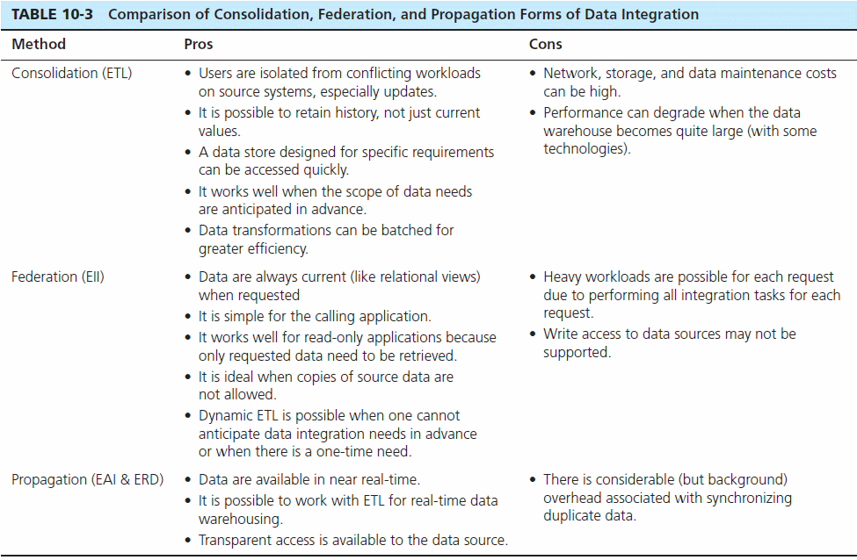

Slide 18
The ETL Process
Capture/Extract
Scrub or data cleansing
Transform
Load and Index
ETL = Extract, transform, and load

Slide 19
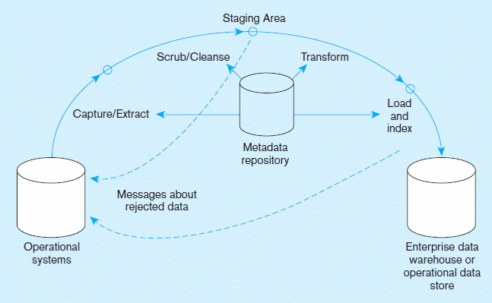
Capture/Extract…obtaining a snapshot of a chosen subset of the source data for loading into the data warehouse
Figure 10-1 Steps in data reconciliation
Static extract = capturing a snapshot of the source data at a point in time
Incremental extract = capturing changes that have occurred since the last static extract
Notes:
More slides. next

Slide 20
Scrub/Cleanse…uses pattern recognition and AI techniques to upgrade data quality
Figure 10-1 Steps in data reconciliation
(cont.)
Fixing errors: misspellings, erroneous dates, incorrect field usage, mismatched addresses, missing data, duplicate data, inconsistencies
Also: decoding, reformatting, time stamping, conversion, key generation, merging, error detection/logging, locating missing data

Slide 21
Transform = convert data from format of operational system to format of data warehouse
Figure 10-1 Steps in data reconciliation
(cont.)
Record-level:
Selection–data partitioning
Joining–data combining
Aggregation–data summarization
Field-level:
single-field–from one field to one field
multi-field–from many fields to one, or one field to many
Notes:
Example if an address that can go from one field to many field

Slide 22
Load/Index= place transformed data into the warehouse and create indexes
Figure 10-1 Steps in data reconciliation
(cont.)
Refresh mode: bulk rewriting of target data at periodic intervals
Update mode: only changes in source data are written to data warehouse

Slide 23
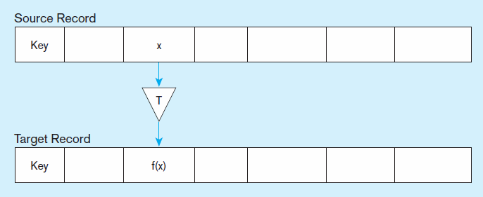
Figure 10-2 Single-field transformation
a) Basic Representation
In general–some transformation function translates data from old form to new form

Slide 24
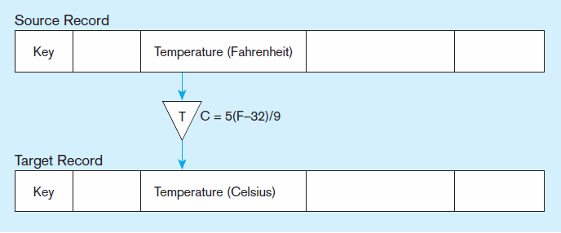
Figure 10-2 Single-field transformation (cont.)
b) Algorithmic
Algorithmic transformation uses a formula or logical expression

Slide 25
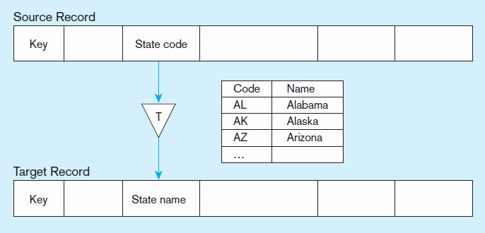
Figure 10-2 Single-field transformation (cont.)
c) Table lookup
Table lookup–another approach, uses a separate table keyed by source record code

Slide 26
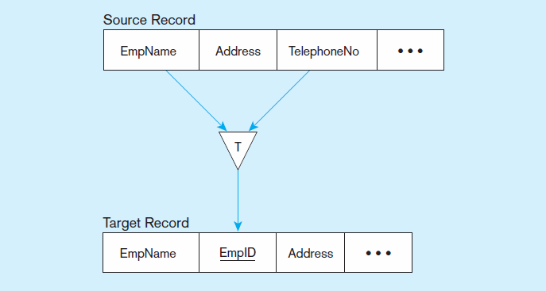
Figure 10-3 Multi-field transformation
a) Many sources to one target

Slide 27
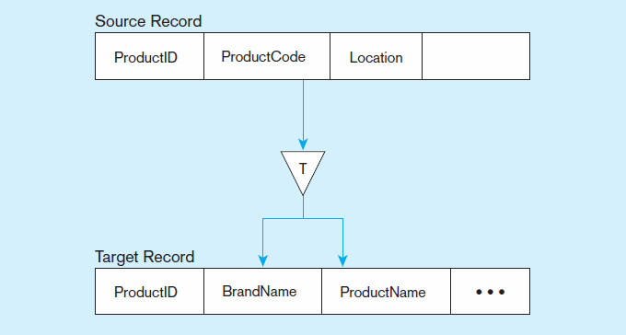
Figure 10-3 Multi-field transformation (cont.)
b) One source to many targets

